Slide 1
WARRNAMBOOL COMMUNITY GARDEN IS A COMMON GROUND WHERE ALL PEOPLE ARE WELCOME TO COME TOGETHER IN A SPIRIT OF MUTUAL SUPPORT AND FRIENDSHIP TO GROW, LEARN, PRODUCE AND SHARE.

Slide 2
Educationally?
WCG is a fantastic educational resource for the Warrnambool and district community

Slide 3
Firstly, some very broad information on what’s at WCG:
Gardening – almost any aspect of gardening you can imagine, from just coming for a look to long term growing on site. Get ideas for school gardens, home garden, ANY gardens ... and advice from experts in successful cultivation.
Outdoor play for young children – mud kitchens, children’s’ garden, chooks ...
Science – endless opportunities in a site that varies from highly managed gardens following organic principles to the feral wilderness of the quarry and wide property margins.
Art – endless opportunities from photography to collage to drawing to ... wherever your imagination leads you.
Geography – close access to the old quarry wall. Linking the quarry to the use of local products in building. Overlooking one of Warrnambool’s largest drained swamps (the racecourse area).
History – this site involves or overlooks important sites for local indigenous history and local 19th/20th century industrial history.
Food technology – vegetables & fruits, herbs, bush foods, backyard food production, ...

Slide 4
Now, a few more detailed ideas ...

Slide 5
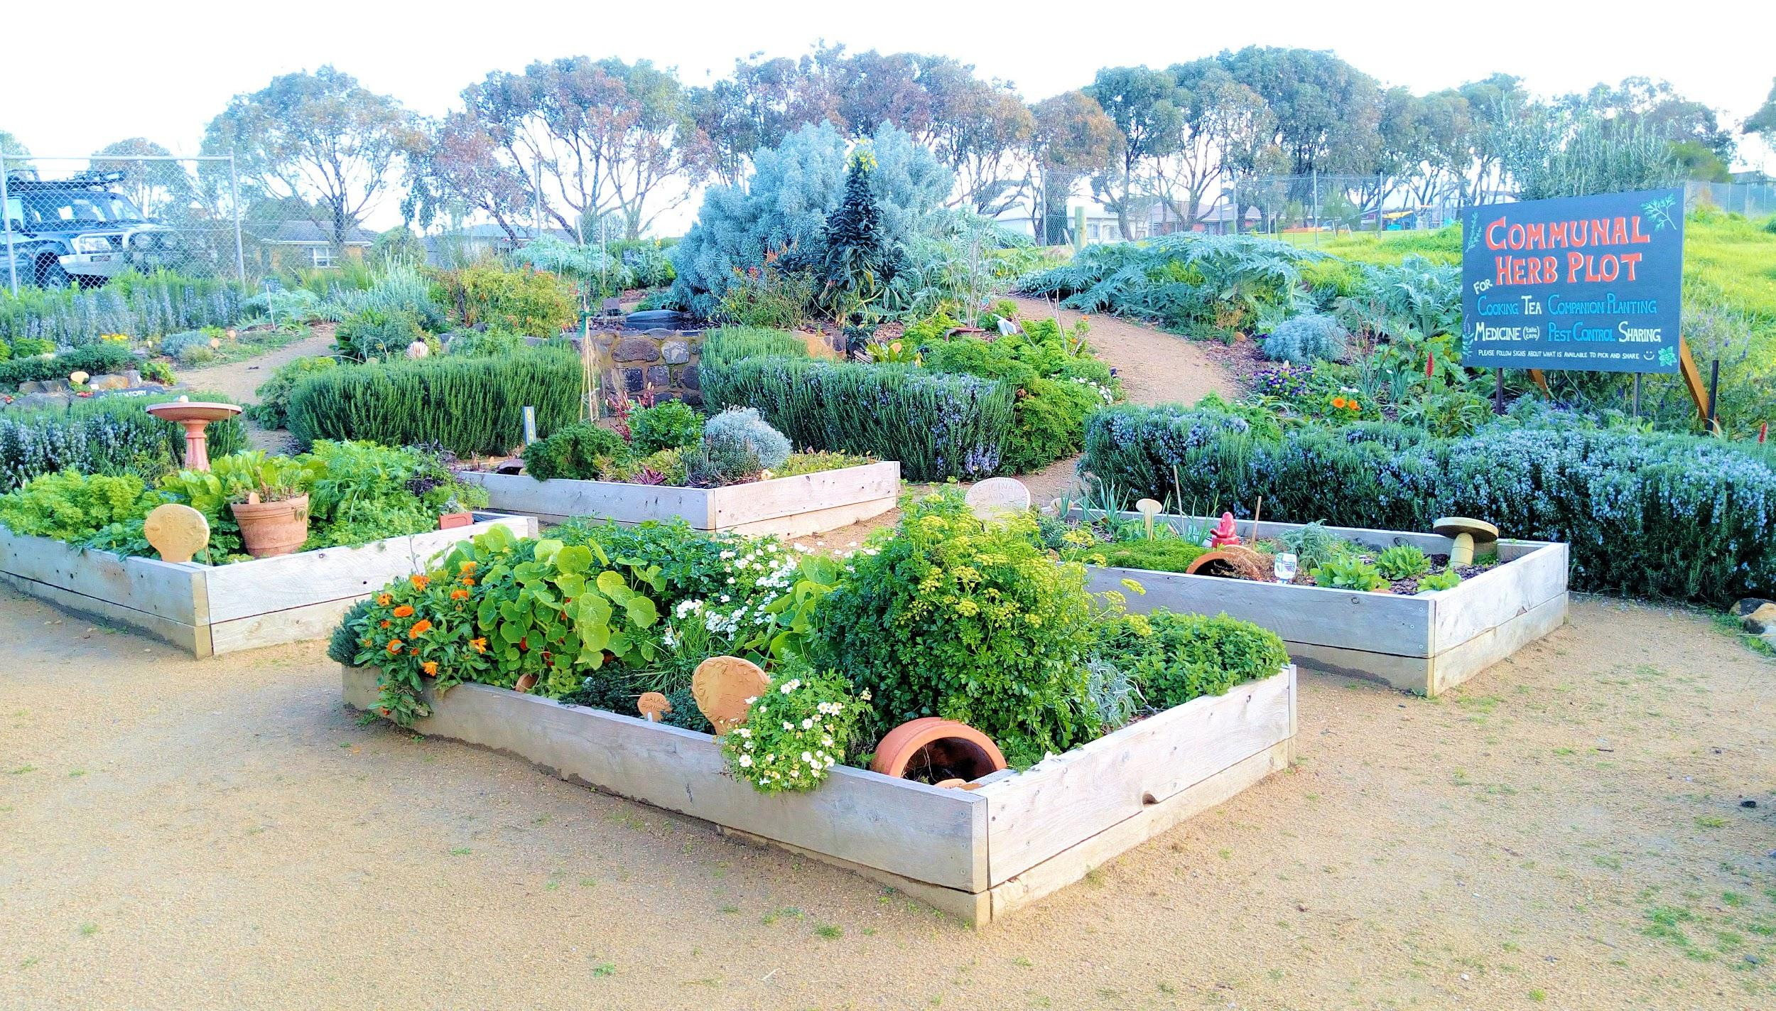
Garden Tours and Activities
See, touch, smell.
o Herb garden. Smell, taste & feel.
o 450 litre worm farm. Learn, feel, & see.
o Big hothouse. Walk in and feel the air.
o Chooks. Get close, make friends.

Slide 6
Garden Tours and Activities
Show students what can be achieved in gardens – inspiration and aspiration.
o Mixed gardens. What most schools will do on their own site.
o Monoculture gardens. How supermarket vegies are mostly grown.

Slide 7
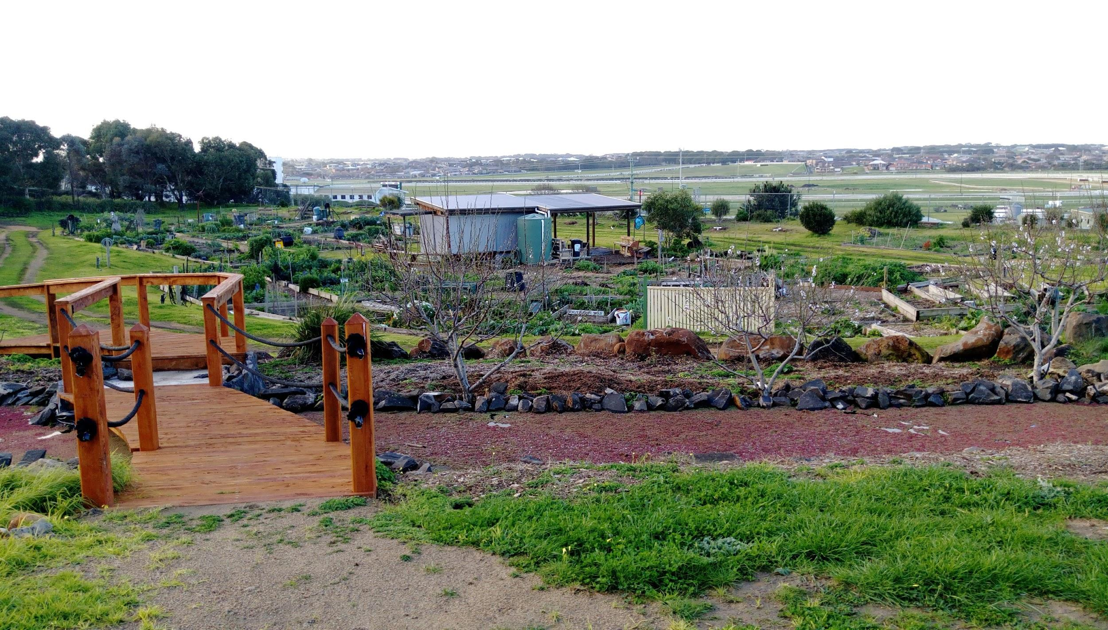
Garden Tours and Activities
Have tours focused on your group’s needs.
o Guided tour with discussion. Educational and/or play activities available.
o Pollination / pollinators.
o Companion planting.
o Growing and using herbs.
o Enriching / improving soil. Mulch, compost, worm tea, and advanced ideas like biochar and rock minerals.

Slide 8
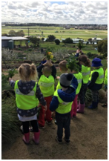
Broad age range
Preschools and kindergartens.
Primary schools.
Secondary schools.
Post-secondary.
Other community groups.
Tours, talks and activities - or actually play a role at WCG.
Learning through doing, demonstration, instruction and play (mud kitchen & kids’ garden).

Slide 9
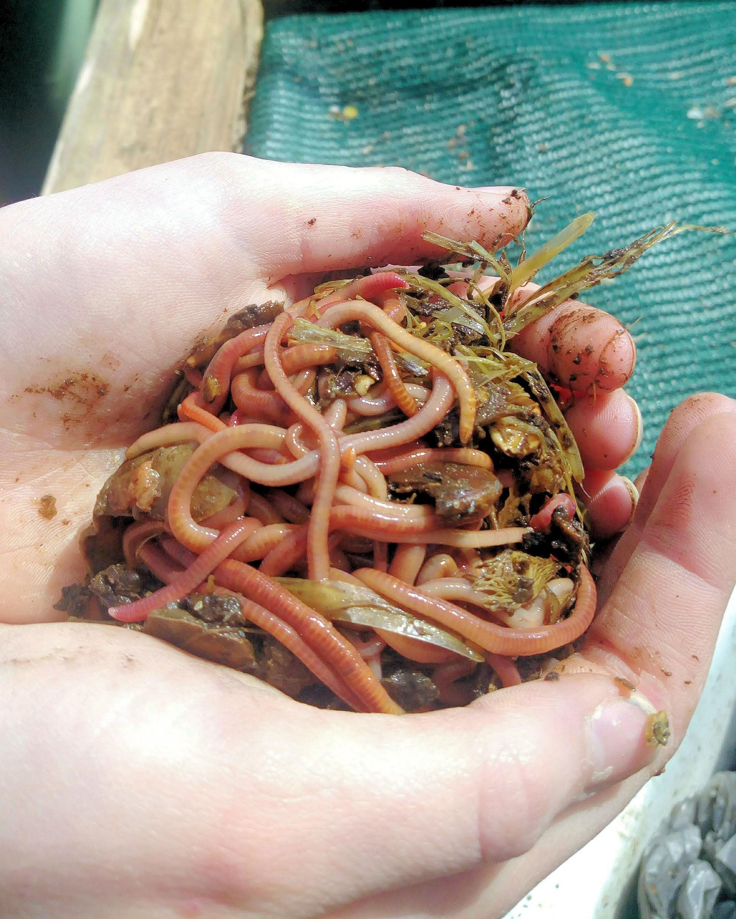
Gardening design and soil improvement
Garden layout in terms of hard design.
Soil composition and amendment.
Flat garden beds, raised beds and terracing.
Plant positioning for sun.
Composting and using composted products, animal manures, green manures, soil testing, mulches ...
Worm farms & composting toilets.
Companion planting – soil enrichment, pest deterrent, beneficial attractants, ...

Slide 10
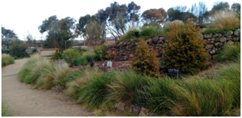
Bush food garden
Still a young garden, so essentially a WCG research project into what native foods will grow successfully in what Warrnambool conditions.
Locally endemic species (eg river mint) as well as better known sub-tropicals (eg finger limes).
Being developed with input from both local lore and commercial bush food producers.

Slide 11
Visit the Chooks
Poultry in suburbia.
Get close.
Lots of breeds.
Recyclers extraordinaire - but there are limitations.

Slide 12
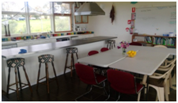
The HUB Educational and Kitchen Space
Commercial kitchen.
Meeting room / classroom.
Outdoor gathering area.
Wood fired pizza oven.

Slide 13
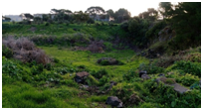
The Old Quarry and Other Marginal Areas
Future development space, but for now a possible site for extended investigations.
Geography, history, construction – Warrnambool’s last working sandstone quarry (last worked early ‘60’s).
Use in conjunction with reclaimed areas such as Tower Hill and the Tozer Reserve to look at land reclamation processes.
“Own” a section for a period of time – maybe experiment with weed reduction or strip a section back to bare dirt and observe weed colonisation over time.
“Pick My Project” development - follow the quarry’s renewal into community space 2018/2019.

Slide 14
WCG is looking to provide opportunities for local educational organisations and the broader community
Contact us if you think we can help you achieve your educational and/or broader goals ...
Facebook: @warrnamboolcommunitygarden
Website: www.wcg3280.org.au
Email: warrnamboolcommunity@yahoo.com.au

